Slide 1
Chemical messengers
The endocrine system

Slide 2
Organisation and communication
The nervous system and endocrine system coordinate the various tissues, organs and systems.
The nervous system does so through nerve impulses
The endocrine system does so through the release of chemical messengers.

Slide 3
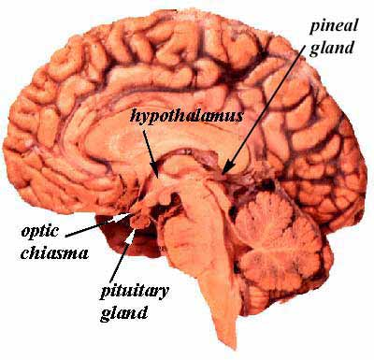
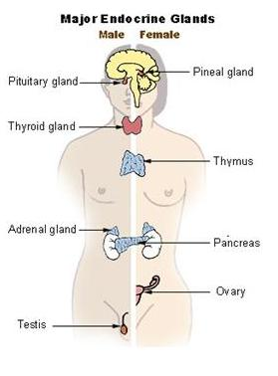
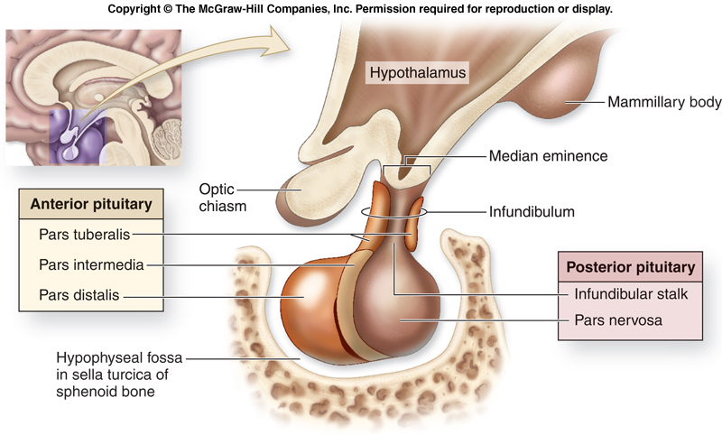

Slide 4
Endocrine system and homeostasis
In our studies on homeostasis we will discuss some of the important chemical messengers involved:
  Insulin and glucagon (pancreas)
  Thyroxine (thyroid)
  Adrenaline, noradrenaline and cortisol (Adrenal glands)
  And a lot more

Slide 5
Feedback systems
The body responds to a stimulus and the response alters the original stimulus
Negative feedback – works to reduce the stimulus
Positive feedback – will amplify the stimulus

Slide 6
The feedback loop
Stimulus – the change in environment causing the system to operate
Receptor – detects the change
Modulator – the control centre. Processes the information sent from the receptor and causes the effector to act.
Effector – carries out the response.
Response – the change implemented by effector.
Feedback – the original stimulus has been changed.

Slide 7
Endocrine and Exocrine glands
Exocrine glands secrete into a duct that exits the body. E.g. sweat glands or salivary glands
Endocrine glands secrete hormones into the extracellular fluid that surround the gland. It is taken up by the capillaries and transported around the body by the blood.
Endocrine glands have no ducts.

Slide 8
Hormones
Proteins, steroids (a class of carbohydrates), amines (contain NH₂ functional group)
May target all cells or only a particular group of cells (target cells/target organs)

Slide 9
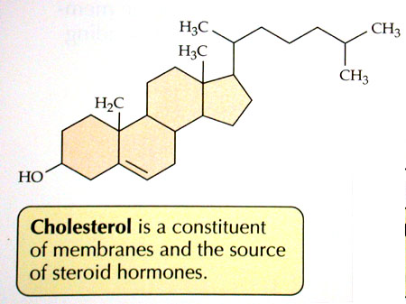
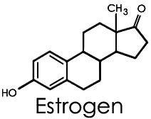
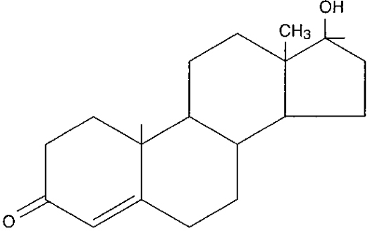
Steroids
testosterone

Slide 10
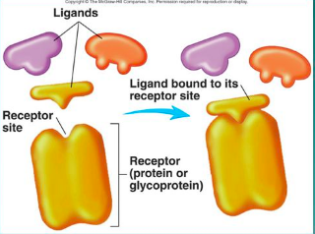
Receptors
A hormone can only influence a cell if they have the correct receptor for the hormone.
Once all the receptors are bound by hormones saturation has occurred and the hormone effect cannot be amplified any further.

Slide 11
Receptors
Protein and amine hormones bind to receptors on the cell membrane. The receptor causes a secondary messenger to be released and diffuse through the cell.
Steroid hormones attach to receptors inside the cell. Steroids are lipid soluble and are able to pass through the cell membrane. They will act to switch genes “on” (activate) to synthesise specific proteins.
https://www.youtube.com/watch?v=TgNwxF3aQpE

Slide 12
Cellular effects of hormones
Often related to enzymes – hormones are not enzymes but they may
  Activate a gene to produce a particular type of enzyme or structural protein
  Change the shape of an enzyme to switch it on (or off)
  Change the rate of production of an enzyme of an enzyme or structural protein by changing the rate of transcription or translation.

Slide 13
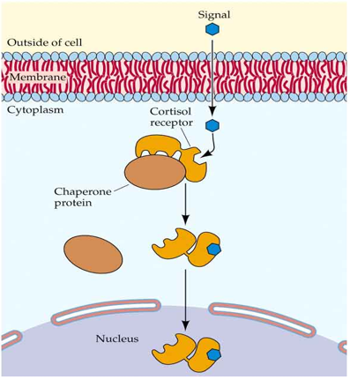
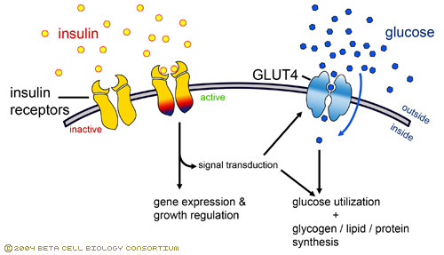
Insulin binds to a receptor on the cell membrane. It causes the glucose channel to begin transporting glucose into the cell. It also stimulates gene expression and growth regulation to store the glucose as glycogen
Cortisol binds to a receptor within the cytoplasm Cortisol acts to increase blood sugar levels. It is released from the adrenal cortex in response to stress and anxiety.

Slide 14
Enzyme amplification
One hormone does not just effect one enzyme – it activates thousands of enzyme molecules
Achieved through enzyme amplification
Cascading effect – the number of reacting molecules involved is increased significantly

Slide 15
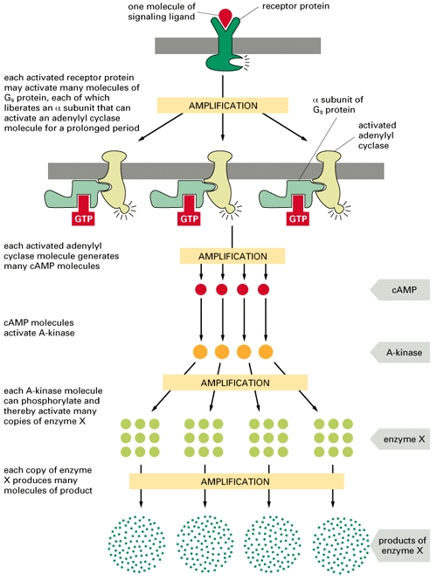
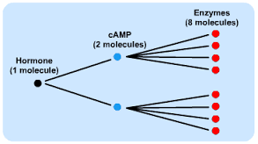

Slide 16
Hormone clearance
Hormone molecules are broken down by the target cells and transported to the liver and kidneys where they are excreted.

Slide 17
Negative feedback control by the hypothalamus
The hypothalamus is able to regulate hormone activity by releasing regulating factors.
These factors in turn regulate the function of the pituitary gland.
Releasing factors – stimulate hormone release
Inhibiting factors – slow down hormone secretion.

Slide 18
Crash course – Endocrine System part 1
https://www.youtube.com/watch?v=eWHH9je2zG4

